Slide 1

Project Luther: Predicting new car prices
Meena Padmanabhan

Slide 2
Objective
Problem statement: Client wants to price a new car in the market based on car specs and features
Question:
What are the factors affecting price of a new car?

Slide 3
Methodology
DATA
Safety features
Price Prediction Model
Engine features
Sales of the Make
Opportunities for Follow-up Analysis
Key Predictors
Drive
Transmission

Slide 4


Dataset
413 car models across 9 makes in 2018 and 2017
Features Scraped from Edmunds.com
Car Sales for the Make from carsalesbase.com
Treatment
Transformed categorical features into dummy variables
30 features – included 20 safety features
Missing values were treated
U.S Sales data for the car make used as proxy for brand performance
Flex fuel and electric cars have not been considered
Notes:
Wider variation of gas vehicles in price, The medians are different for gas and hybrid. Hybrid is skewed

Slide 5
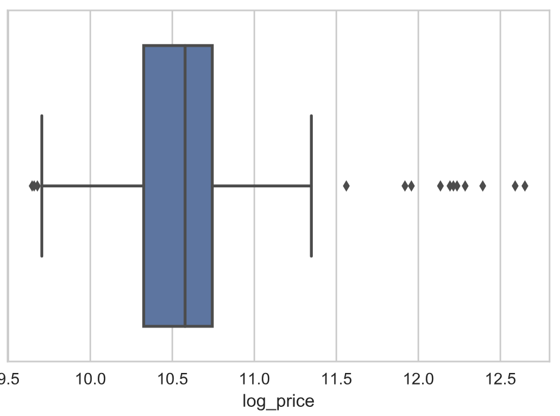
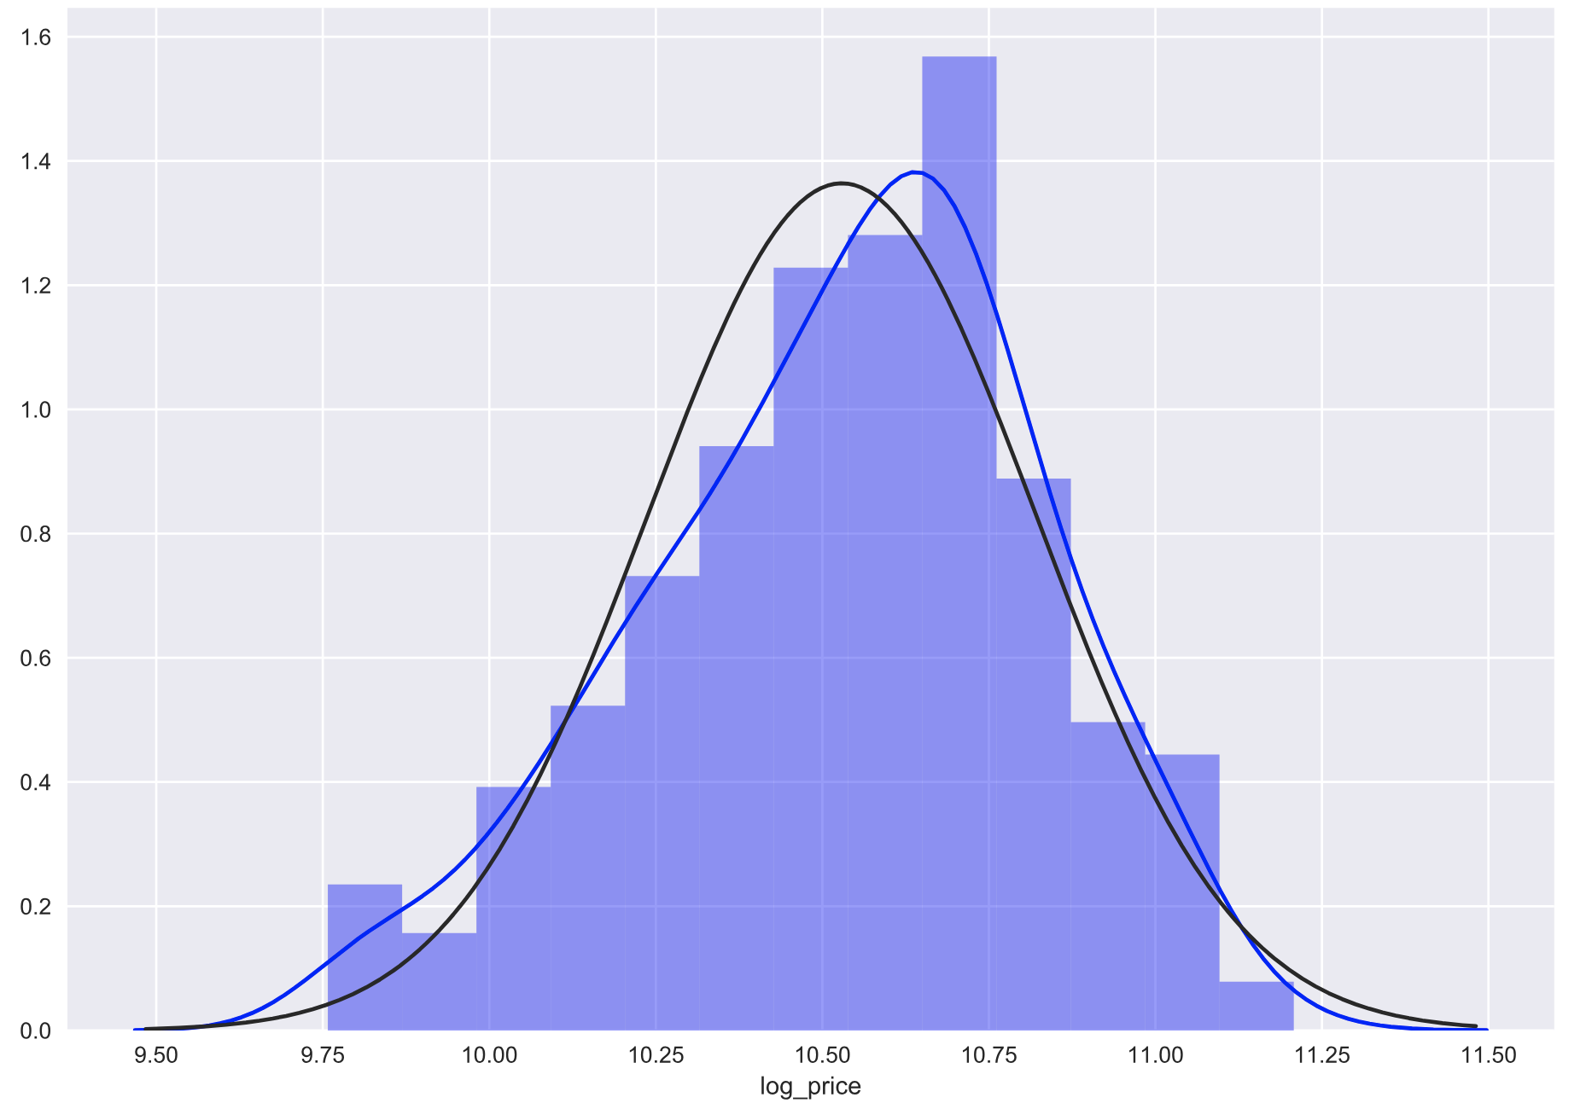
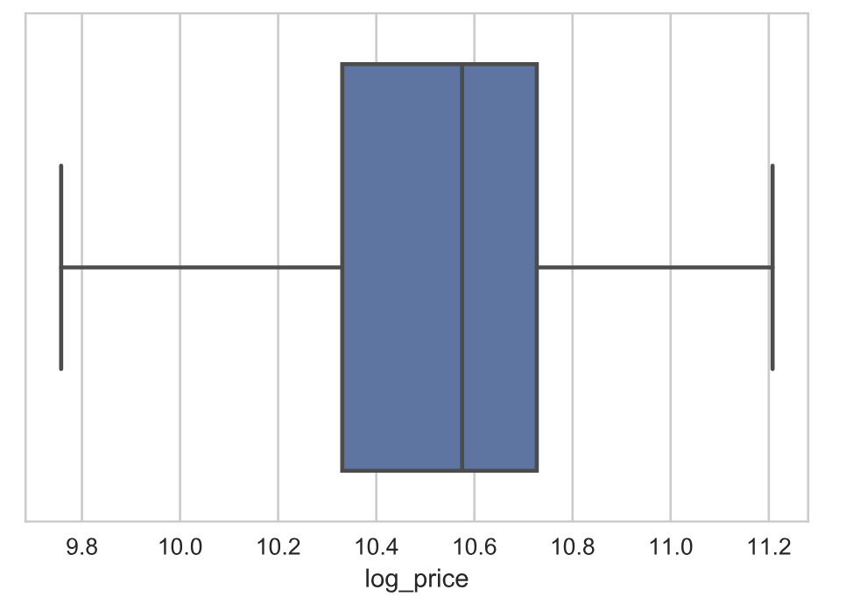
Log of Price chosen as Target variable
Box plots of log of price
Distribution of log of price
Price variable has been log transformed
Outliers (beyond +/- 1.5 IQR) have been removed

Slide 6
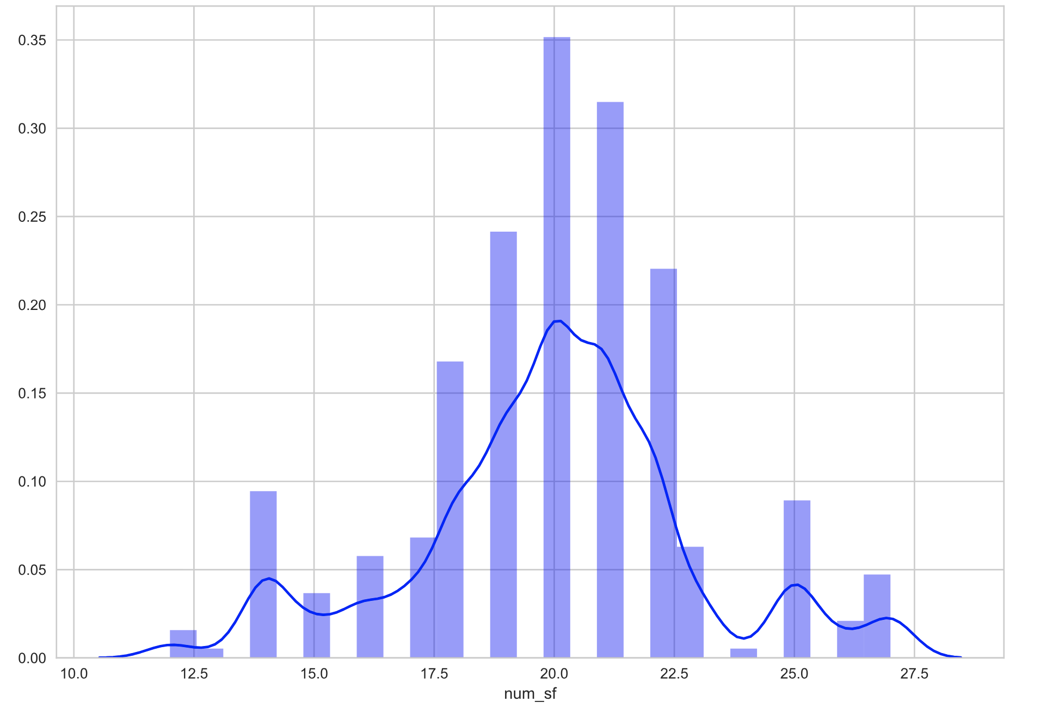
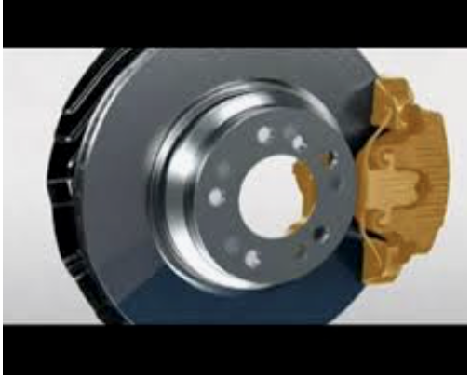
EDA findings
87% of cars run on gasoline and 13% are hybrid
Emergency braking assist , child seat anchors, daytime running headlights, tire pressure monitor exist in more than 95% of the cars
Brake drying, Rear integrated headrests, Passenger airbag deactivation switch exist in less than 5% of the cars
Probability density
Brake drying system – for rainy days
Number of safety features
Notes:
Highly correlated safety features

Slide 7
Model results
R square(Adjusted) - Train | 0.58
R square(Adjusted) - Test | 0.58
Dependent Variable | Log of Price
 | Beta Coefficients | Exp(Beta Coefficients)** | P Value | VIF
Intercept | 9.7 | 17190 | <0.0001 | 12.9
Presence of Auto Delay off Headlamps | 0.08 | 1.07 | <0.0001 | 1.04
Presence of Post Collision Safety System | 0.14 | 1.1573 | <0.0001 | 1.00
Horsepower | 0.0025 | 1.0025 | <0.0001 | 1.04
Training Mean Absolute Error | $5,882
Average Test Mean Absolute Error | $5,964
** Interpretation: Cars with Post Collision Safety System are 15.73% higher-priced than cars without it

Slide 8
Next steps
Scrape data for all cars in the market to increase prediction power
Include data on resale value of cars, brand value, dimensions of the car
Do a break-even analysis and combine with profit margin to determine the price point of the car

Slide 9
Thank you

